Slide 1

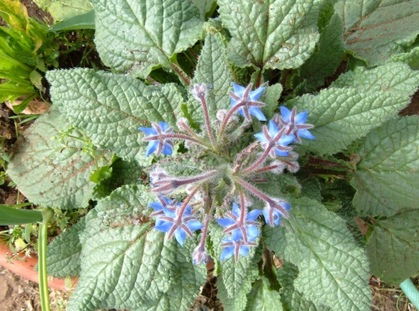
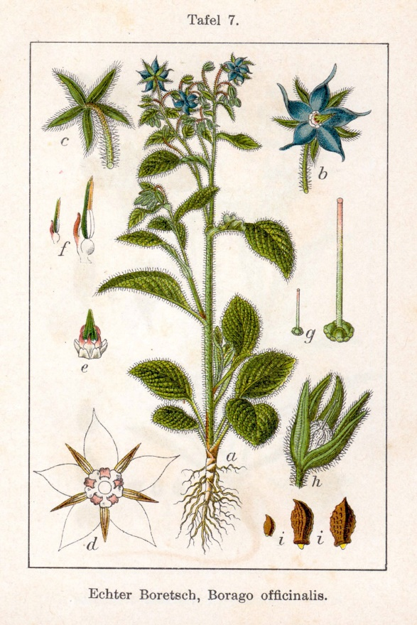
Borragine

Slide 2
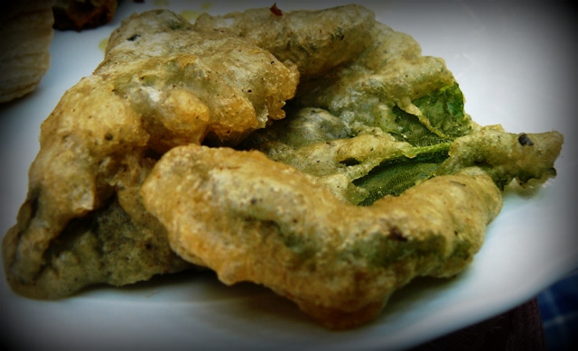
Borage has a good amount of vitamins, in particular vitamin C and minerals especially potassium. The borage flowers have got therapeutic properties, they are a good remedy against cough.
The leaves are a good natural remedy against respiratory tract disorders. Borage has also antipyretic
and sweat properties.
An oil is obtained from the
borage seeds.
The fried leaves are very good
and are part of the ancient
peasant and popular tradition.

Slide 3
Fried borage leaves
Ingredienti:
12 foglie di borragine
Pastella= 100g di farina di semola, ¼ di birra da 66 cl, un pizzico di sale
Mezzo litro d’olio di arachidi
Ingredients:
- 12 borage leaves
- Batter = 100g semolina
flour, ¼ of beer from 66 cl
- a pinch of salt
- a pint of peanut oil

Slide 4
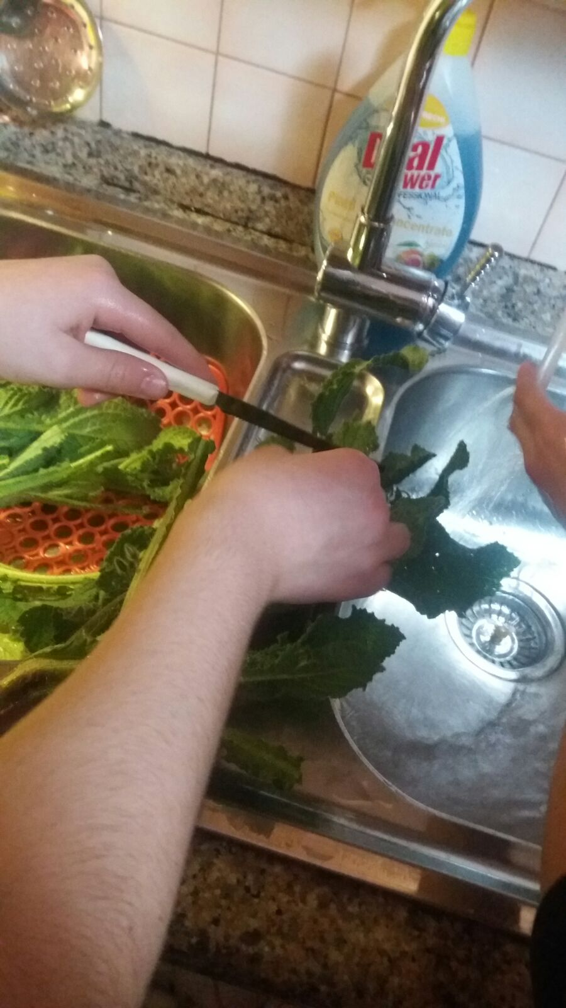
Tagliare e lavare le foglie di borragine
1) Cut and wash the borage leaves

Slide 5
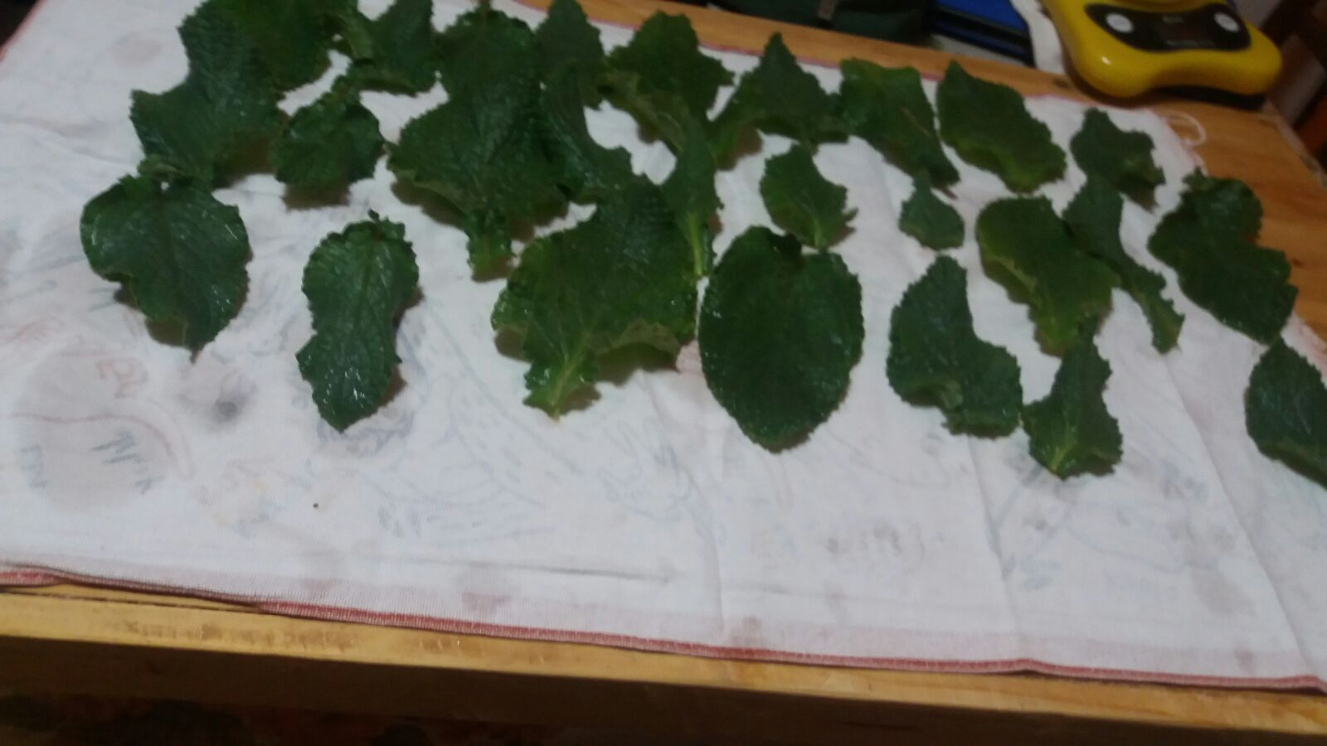
2) Asciugare le foglie
2) Dry the leaves

Slide 6
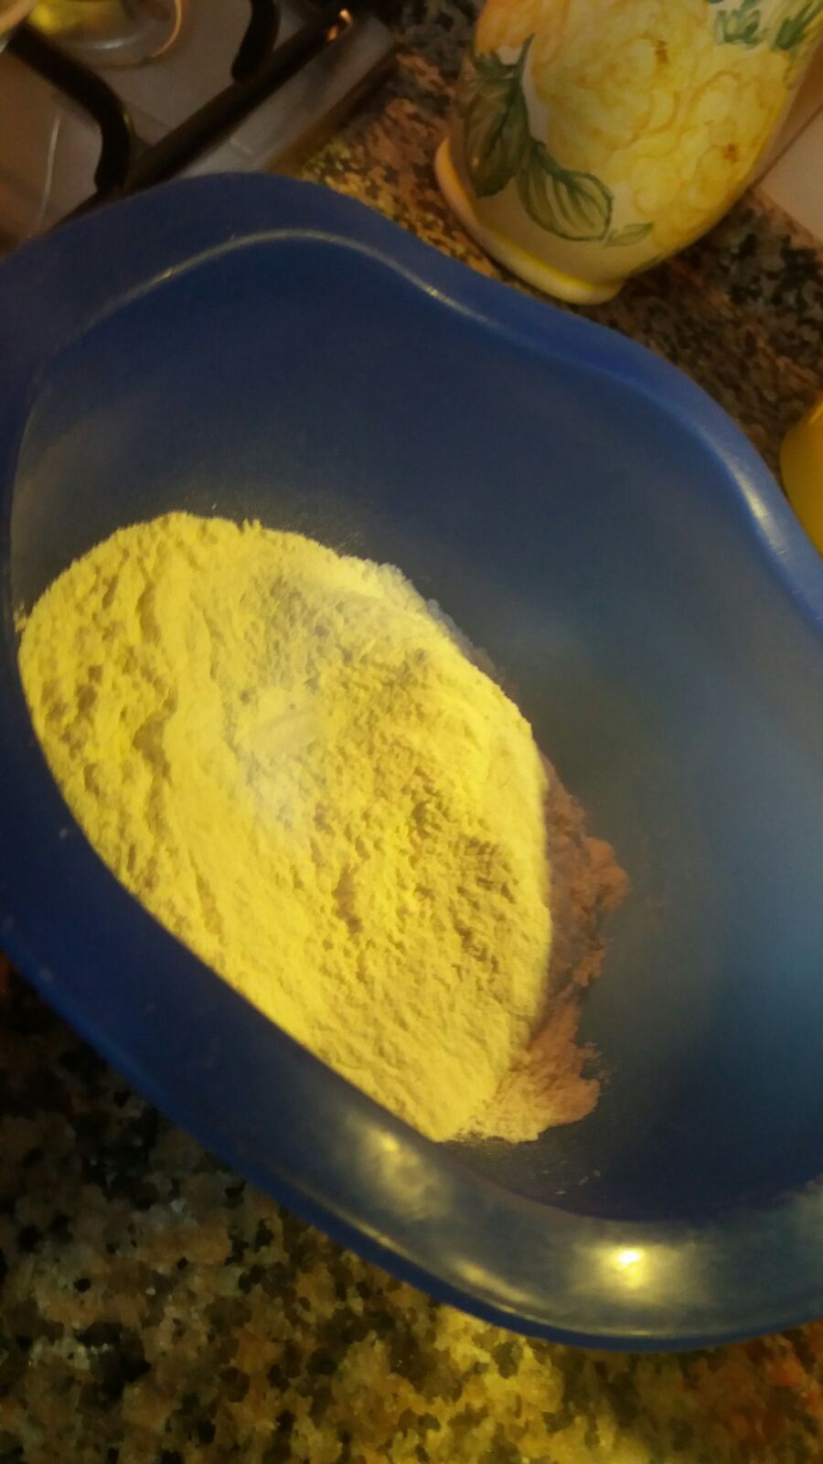
3) Prendere una ciotola e mettere farina e sale
3) Take a bowl and put flour and salt

Slide 7
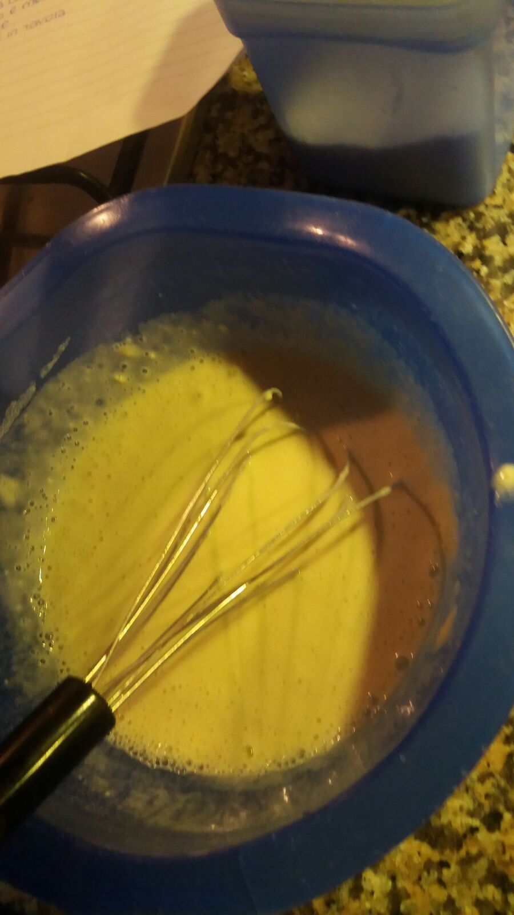
4) Mescolare il tutto con la birra fino a far diventare la pastella omogenea ma non troppo liquida
4) Mix all the ingredients with the beer up to make the homogeneous batter but not too liquid

Slide 8
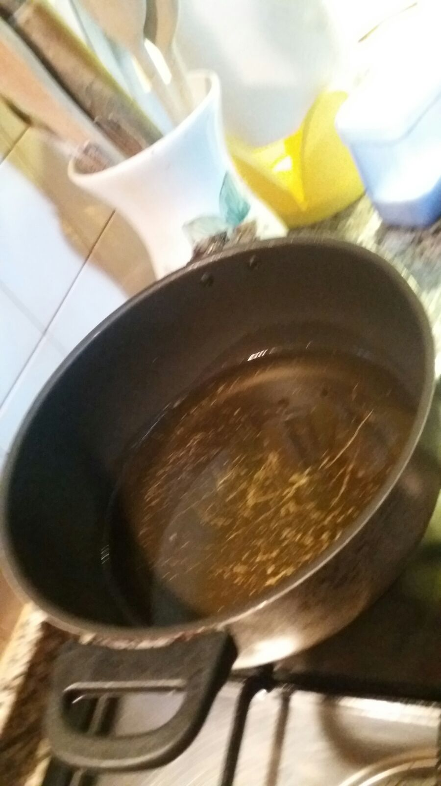
5) Mettere l’olio nella padella a 170°
5) Put the oil in the pan to 170 °

Slide 9
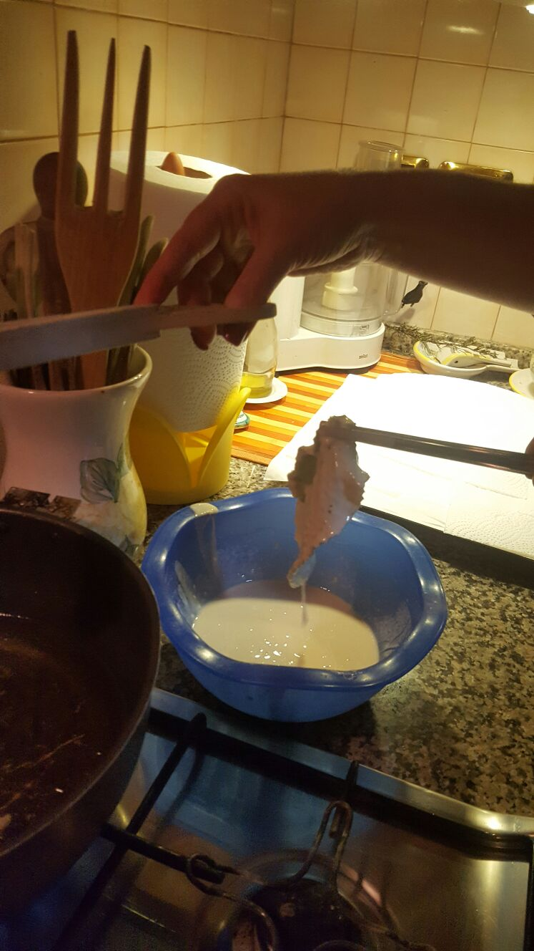
6) Una volta che l’olio è arrivato alla temperatura data, immergere le foglie una alla volta prima nella pastella e poi nell’olio
6) Once the oil has reached the given temperature, soak the leaves one by one first in the batter and then in the oil

Slide 10
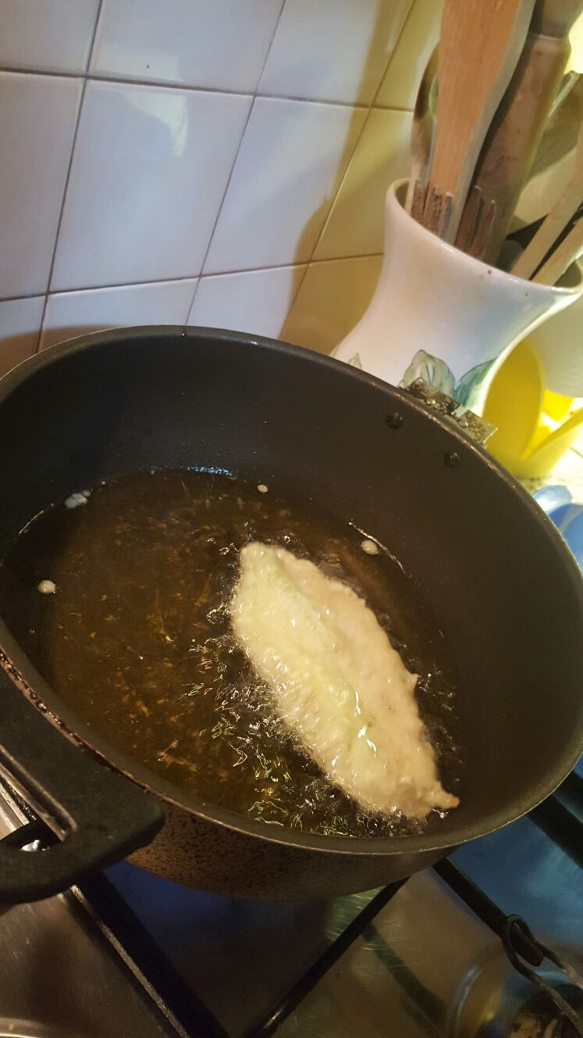
7) Formatasi una crosticina dorata, levare le foglie dall’olio e metterle in un vassoio con carta assorbente
7) As you see a golden crust on the leaves, remove them from the oil and put them in a tray with paper

Slide 11
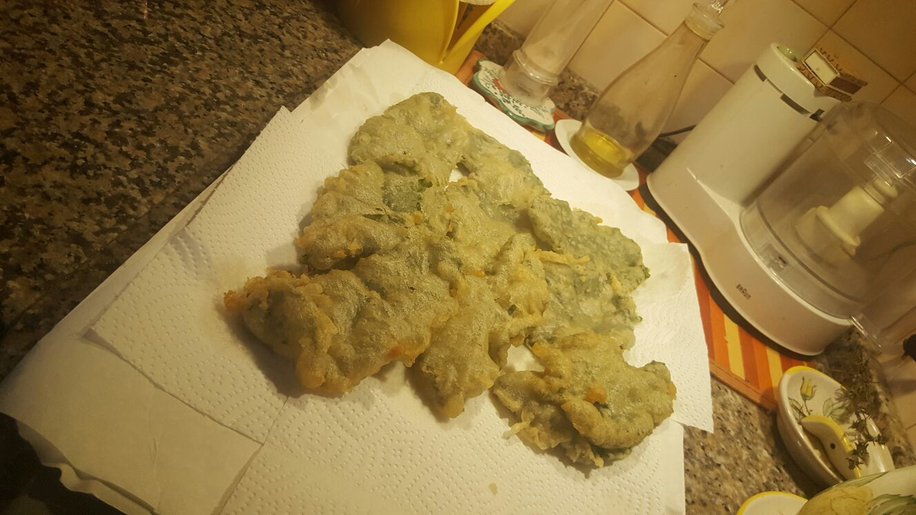
8) Infine mettere le foglie su un vassoio con carta assorbente
8) Finally, put the leaves on a tray with paper

