Slide 1

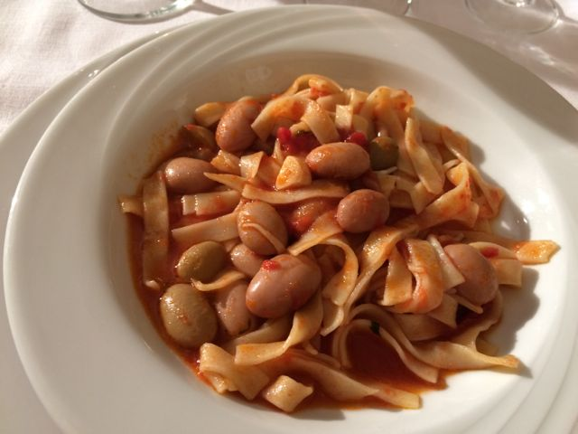
SAGNE E FAGIOLI

Slide 2
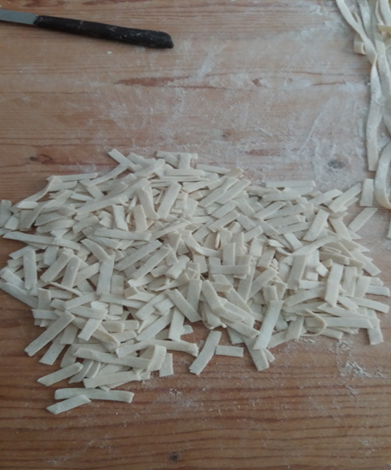
Ingredients for 4 people
Homemade pasta (sagne):
250 g of flour
125 ml of water
a teaspoon of salt

Slide 3
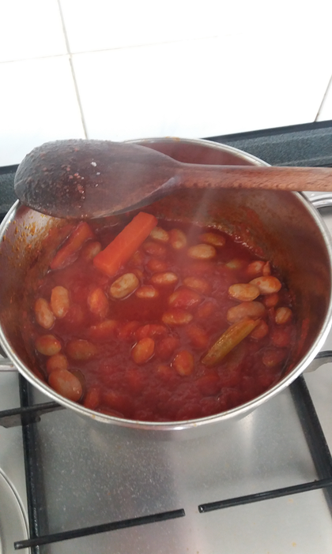
Ingredients for the sauce:
Sauce:
400 g Borlotti beans
4 tablespoons olive oil
2 slices of onion
2 carrots
2 stalks of celery
66 ml of tomato sauce
a pinch of salt

Slide 4
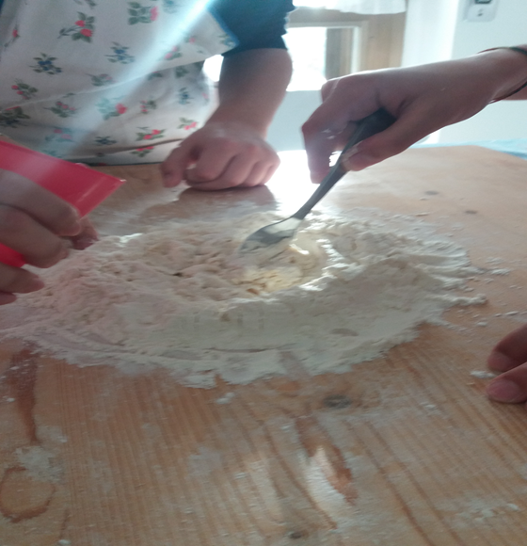
SAGNE
Mound the flour on a kitchen work and
make a well in the middle.
Add salt and water.
Knead with hands.
The dough is hard to work:
use the palm of the hands.

Slide 5
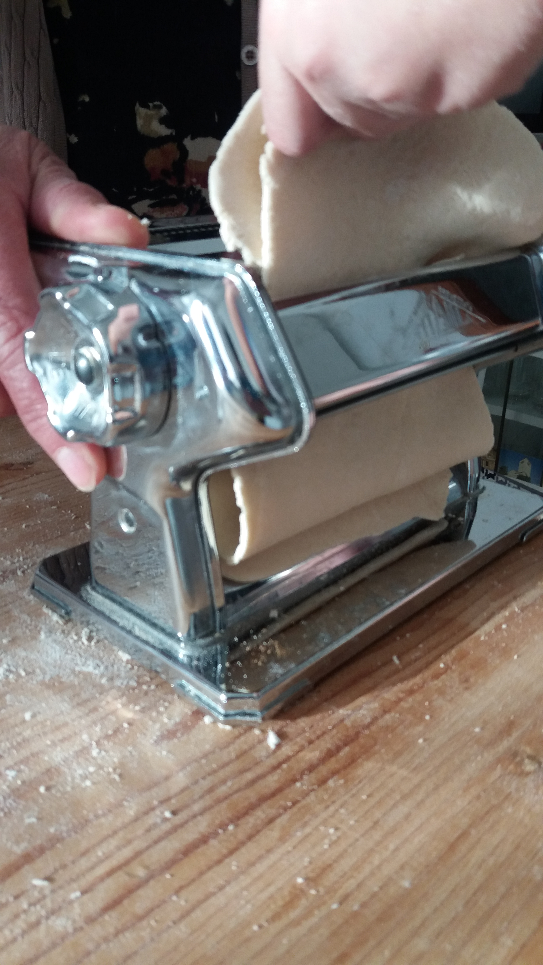
Roll out the dough with a rolling pin or
with a pasta machine:
pass it several times until the dough becomes
smooth and thin. Add flour when you need.
Make several strips.

Slide 6
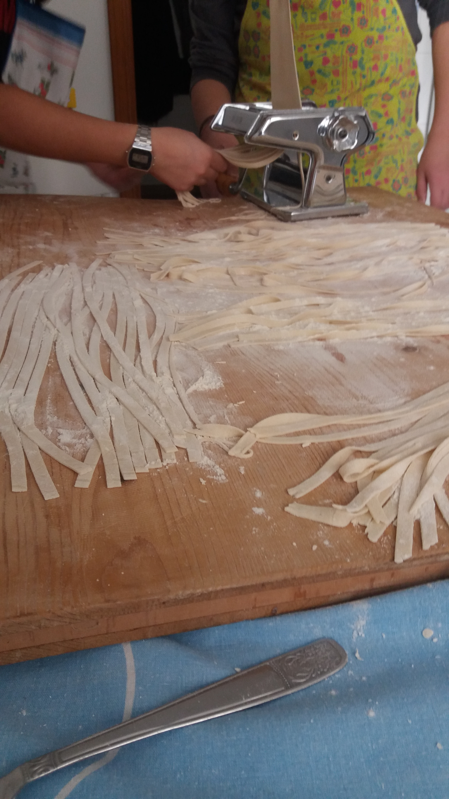
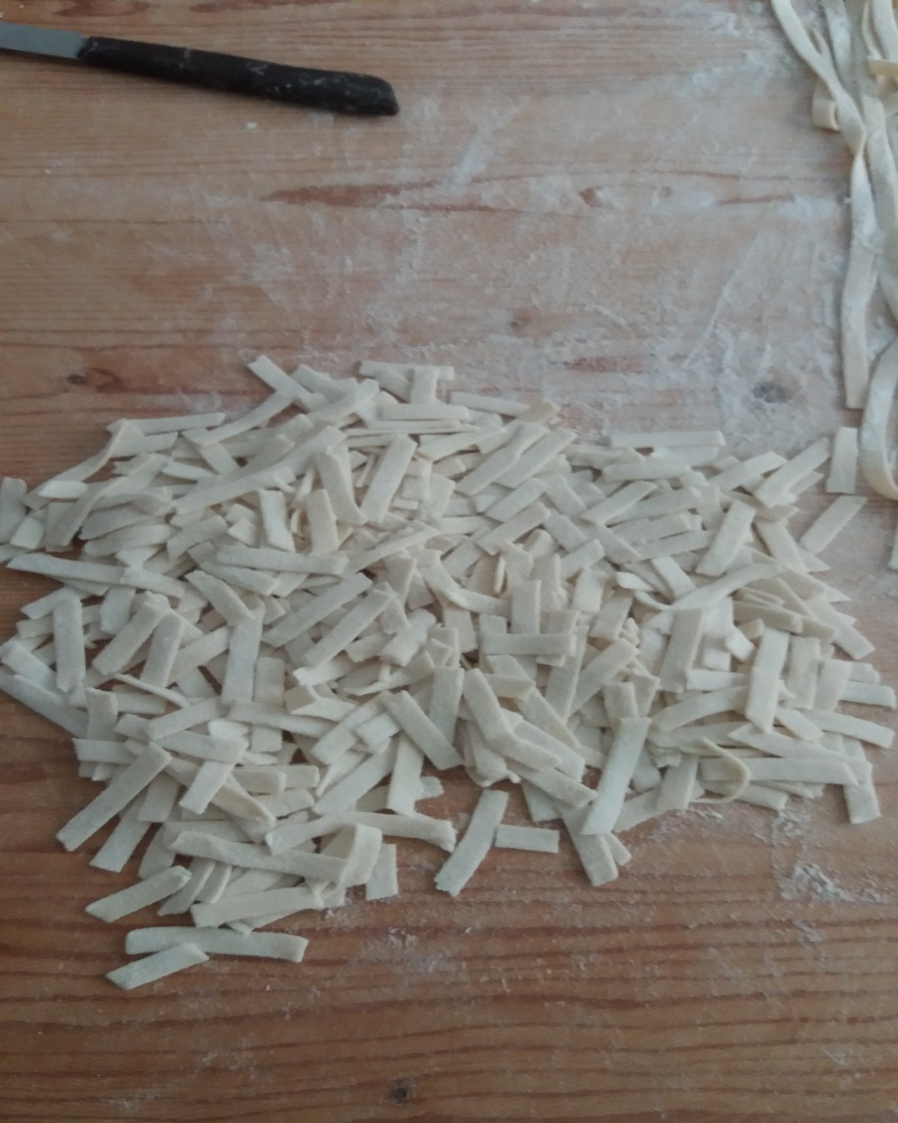
Take a strip and dust with flour. Cut the sagne: size should be
1 cm in width and
6-8 cm in lenght, 1.5 mm thick.
FIRST VERTICAL
HORIZONTAL THEN

Slide 7
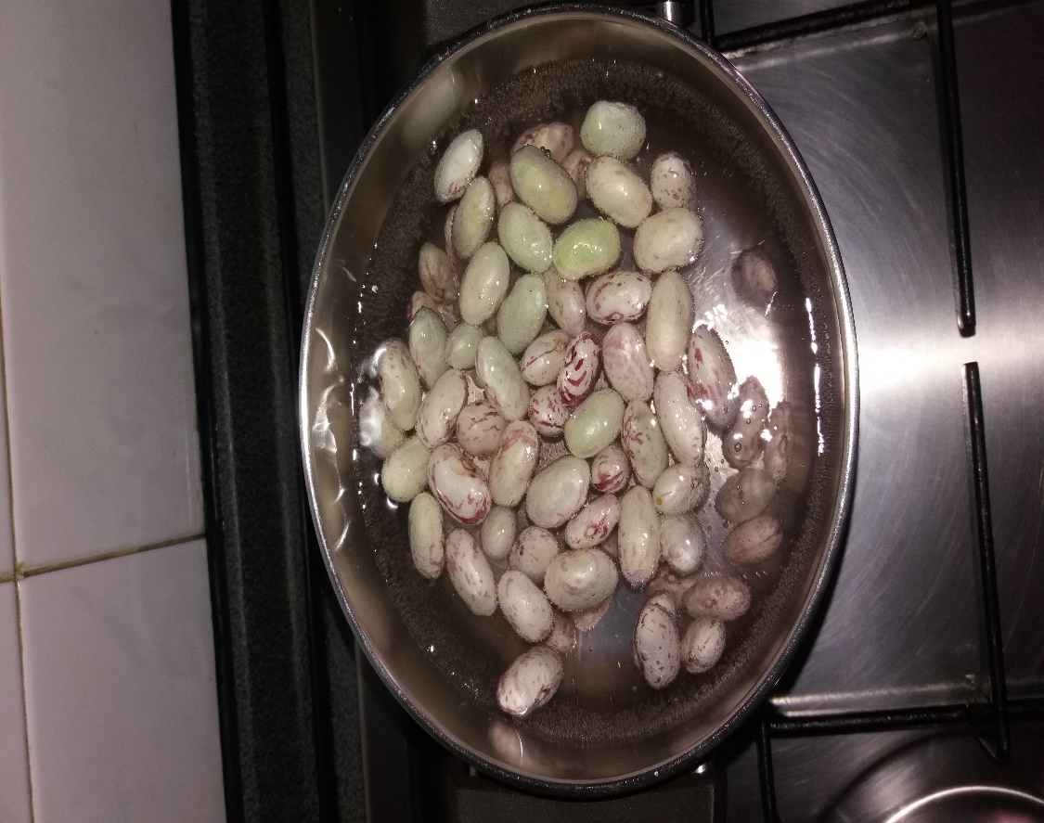
Boil the beans:
put them in a pan, add water, a stalk of celery and carrot.
When the water is hot add salt.
Cover the pot and cook for about 45 minutes.

Slide 8
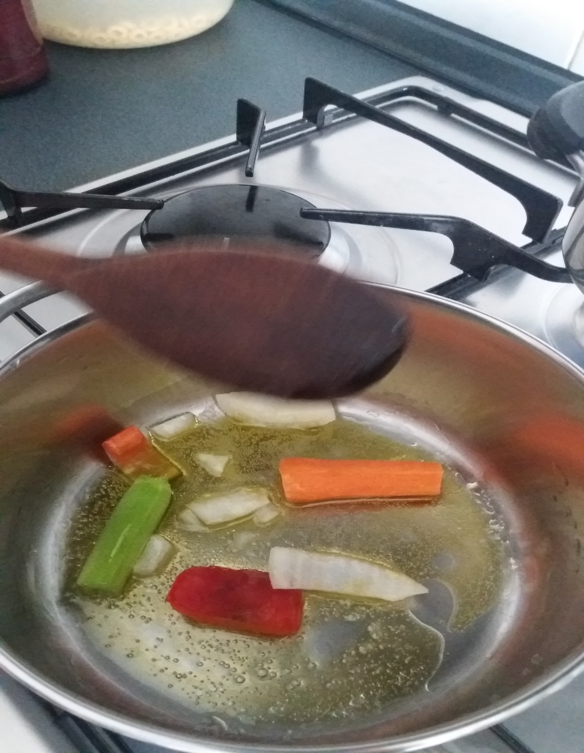
In a pan put the olive oil, the carrot, the onion and the celery. Brown for a couple of minutes.

Slide 9
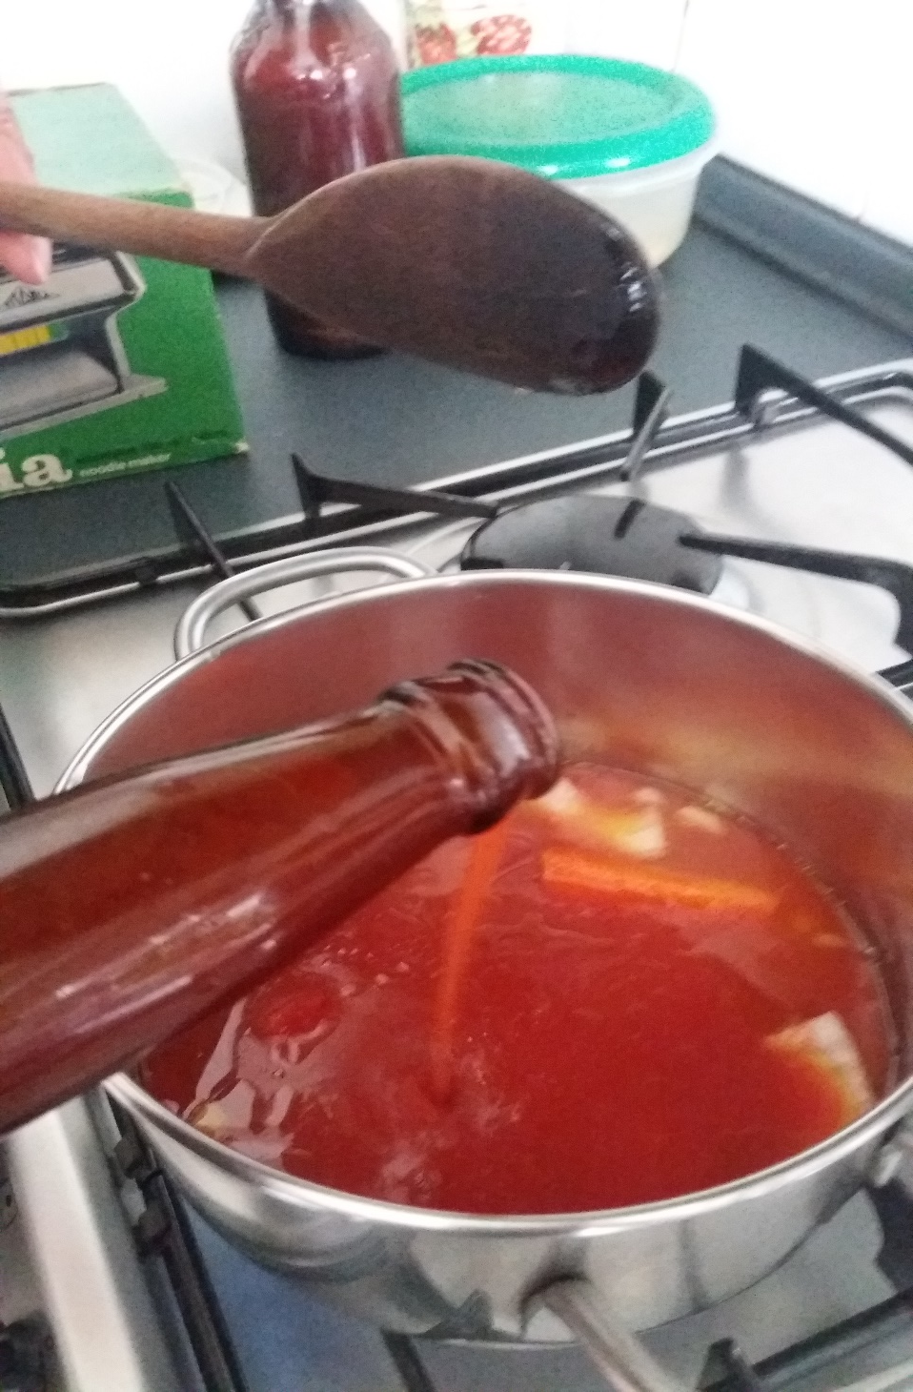
Add the tomato sauce and cook for about 10 minutes.

Slide 10

Add the beans and a ladle of beans cooking water and continue cooking for about ten minutes.

Slide 11
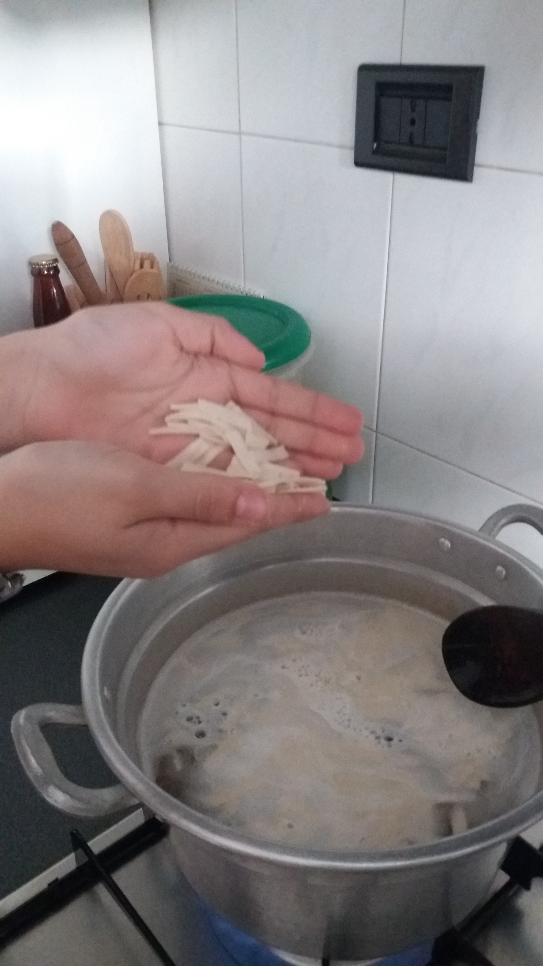
Boil water in a pot, add salt and put the sagne.
Stir gently.
Bring back to the boil for two minutes.
Drain the pasta.

Slide 12
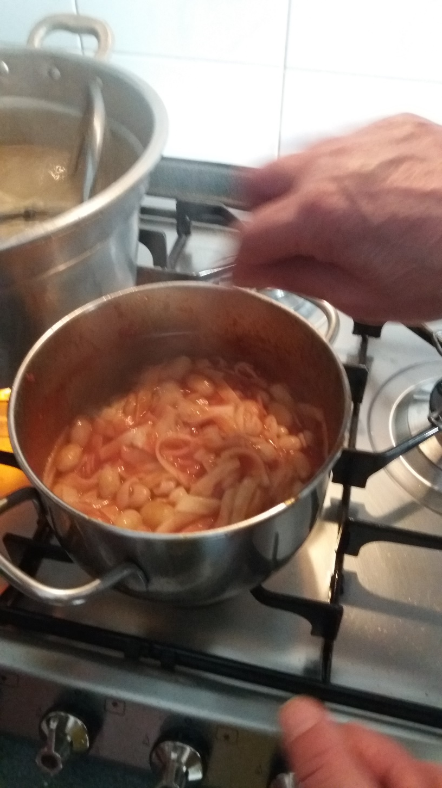
Put the sagne into the saucepan with the beans.
Add a ladle of cooking water from the beans. Stir for a few minutes.

Slide 13
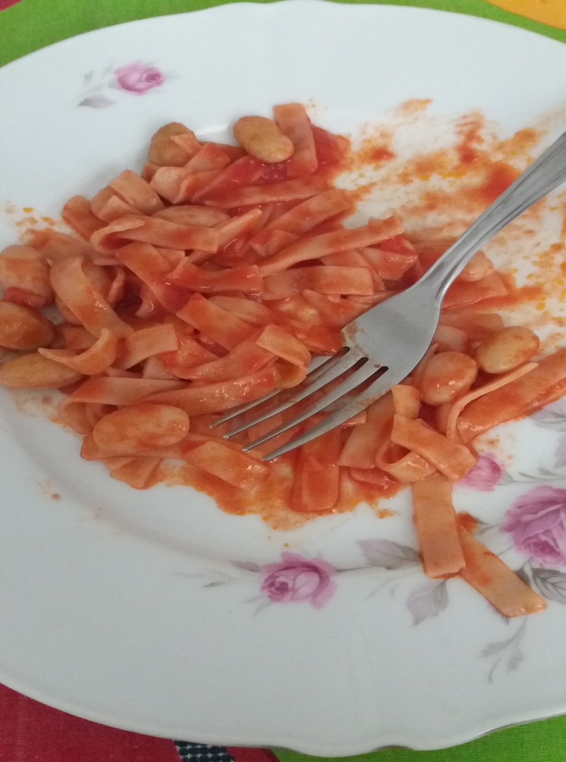
and……..
BUON
APPETITO!!!

